Slide 1
Market Valuation of Listed Companies on NYSE, AMEX, NASDAQ
DSI 16 – Jeriel Wong
Disclaimer: This is educational, there can be losses in investments

Slide 2
If today you would to invest your money in a company, how would you select the company ?
Problem Statement
Technical indicators say it’s going up
‘The company is good ’
Current Ratio
‘I saw on television an analyst recommend this company’
Savvy
Non-Savvy
Gross Margin
Price – to - EPS (P/E)
Price – to - Book (P/B)
‘My friend bought this company stock, and is making money, follow him/her!’
Notes:
You want to do an investment but you don’t know which stock to pick , or actually you do, u believe that this company has an awesome product or an awesome business model

Slide 3
Problem Solution - the financial vitals
A model that predicts the valuation of a company by studying all the listed companies in the three major exchanges.
With such a prediction model, and given the current market valuation of the company, investors can look to invest in such companies, as there is room for the company to grow.
Through this model development, it will also allow investors to know which company’s financial vitals one can look at.

Slide 4

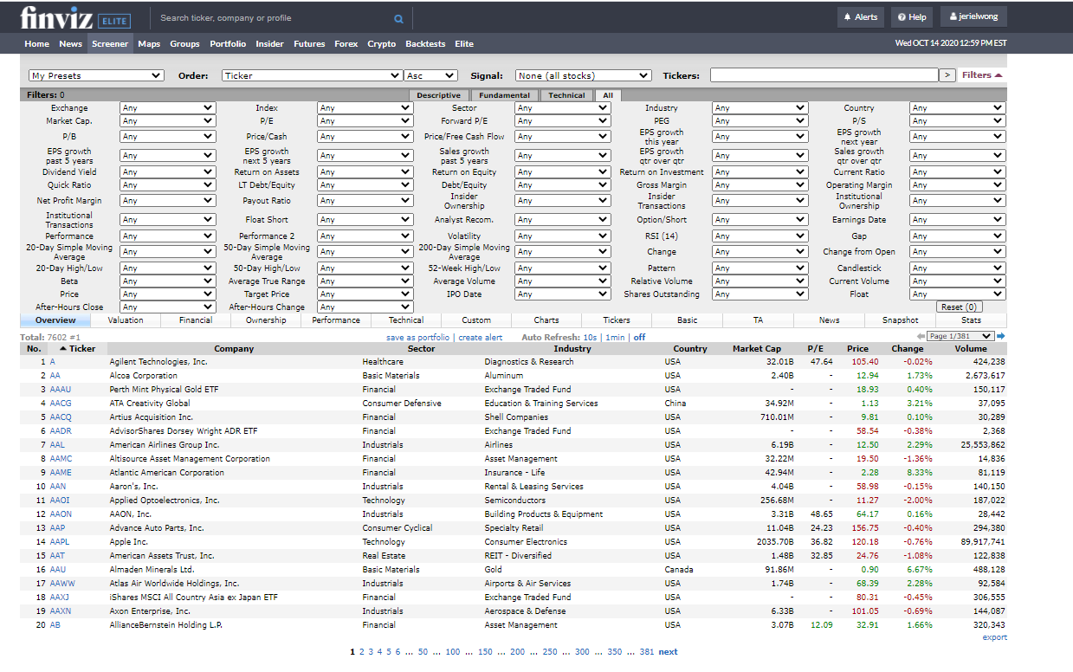
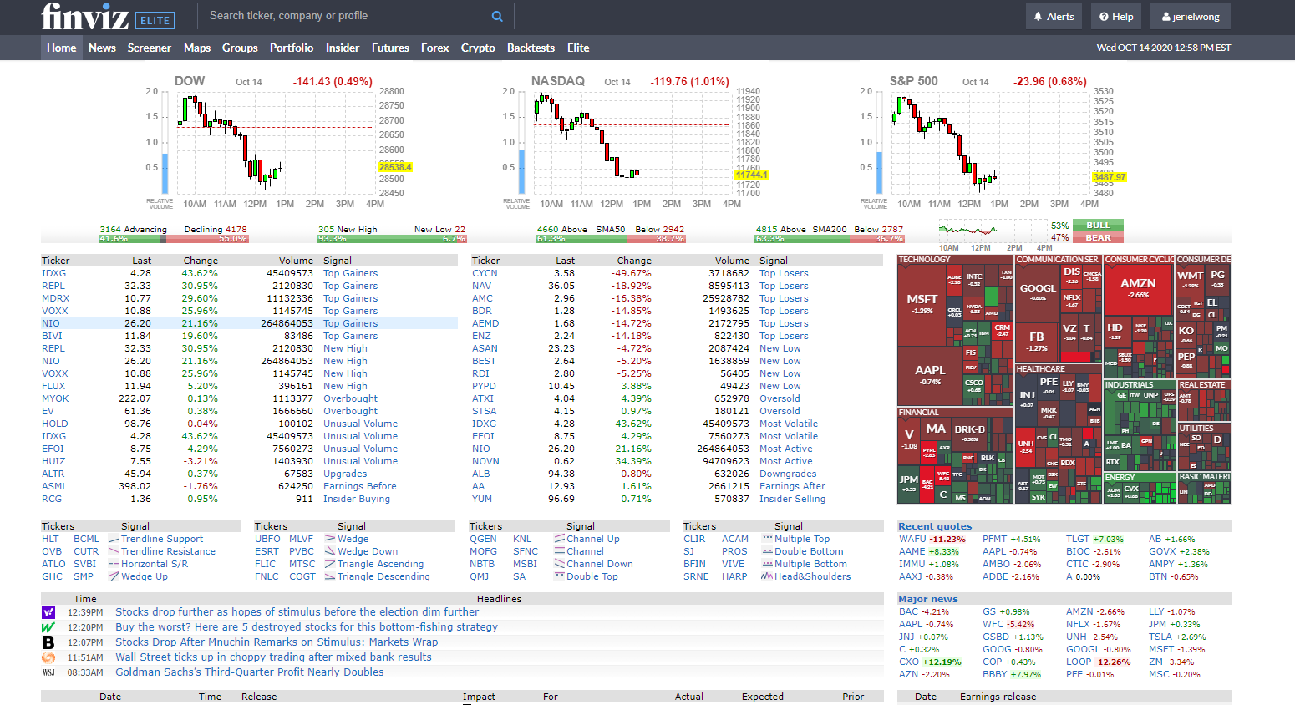
Snapshot of the market
Notes:
FNVIZ is a browser based stock market platform that provides information of the listed companies in the USA.

Slide 5
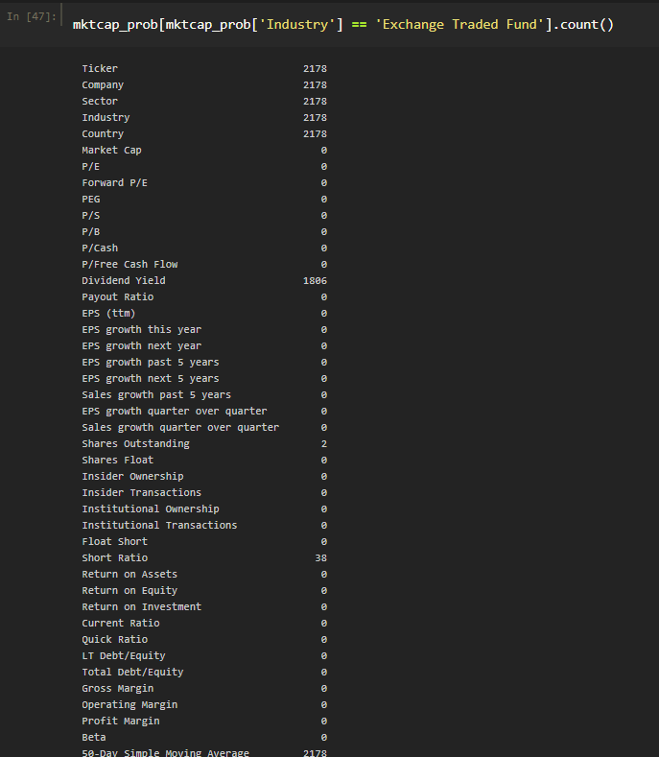
Dataset Insights Exchange Traded Funds
Exchange Traded Funds
No Market Cap
No Financial data vitals, P/E , Forward P/E, PEG, Sales Growth etc.
SPDR S&P 500 ETF Trust
2178 Exchange Traded Funds

Slide 6
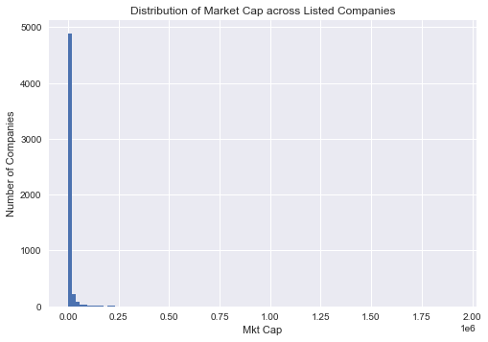
Dataset Insights US $5 Billion
7565 tradeable tickers
2225 listed tickers no market cap
2178 Exchange Traded Funds
47 Shell Companies & Others
1071 listed companies > $US 5 billion valuation , total market cap $US 44.9 trillion
4269 listed companies are actually < $US 5 billion valuation, total market cap $US 3.8 trillion

Slide 7
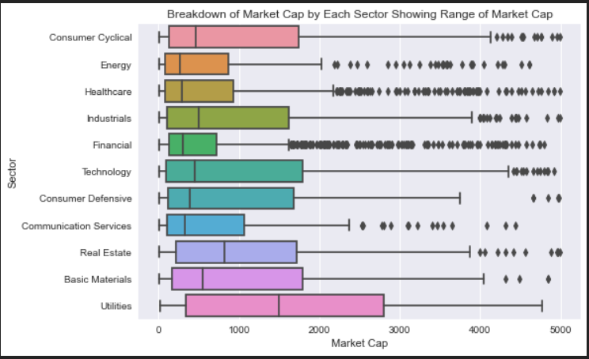
Data Analysis Visualisation - EDA

Slide 8
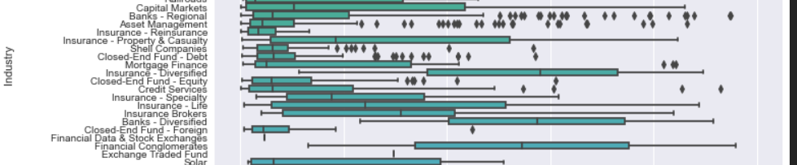
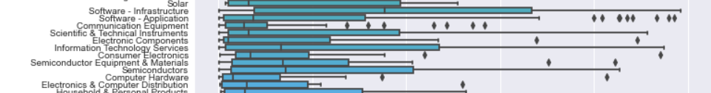
Data Analysis Visualisation - INDUSTRIES
Utilities
Regulated Gas
Financials
Banks Diversified
Technology
Software Infrastructure

Slide 9
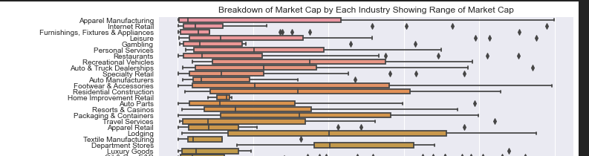
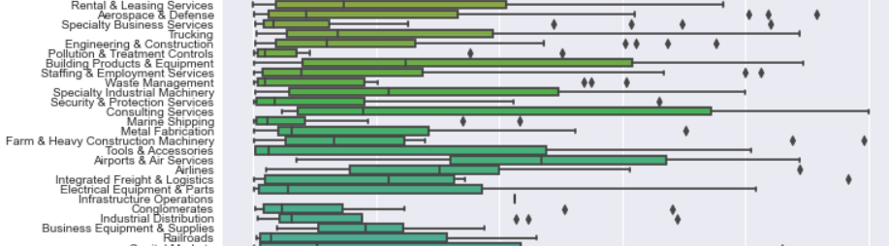
Data Analysis Visualisation - INDUSTRIES
Consumer Cyclical
Department Stores
Industrials
Airports & Air Services

Slide 10
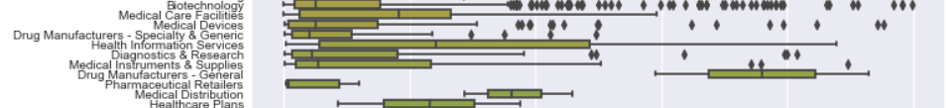
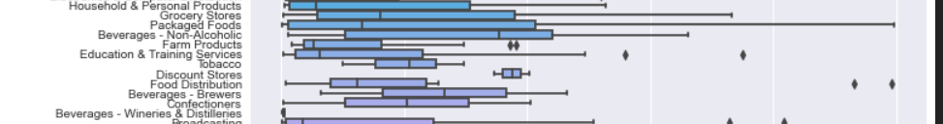
Data Analysis Visualisation - INDUSTRIES
Energy
Oil & Gas Integrated
Data Analysis
via EDA
Healthcare
Drug Manufacturers
Consumer Defensive
Discount Stores

Slide 11
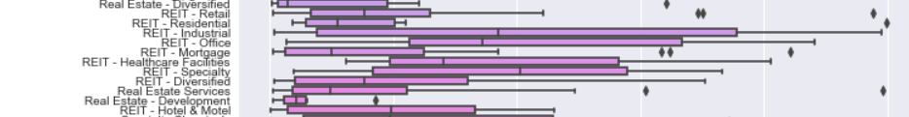
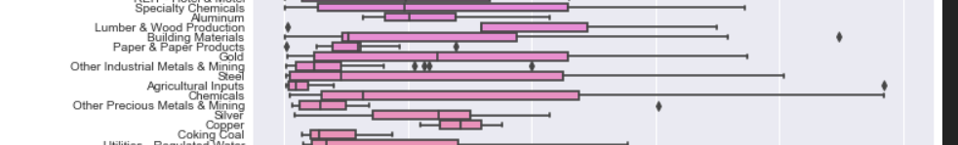
Data Analysis Visualisation - INDUSTRIES
Communication Services
Telecom Services
Real Estate
REIT Speciality
Basic Materials
Lumber & Wood Production

Slide 12
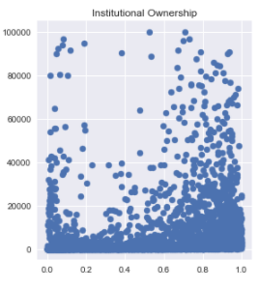
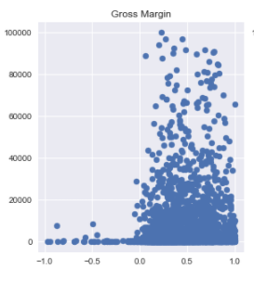
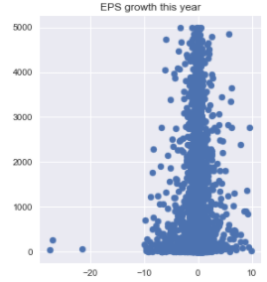
Data Analysis Visualisation – Financial VITALS
Earnings Per Share
Institutional Ownership
Gross Margin
Notes:
EPS = The amount of company’s profit per outstanding share for the company fiscal year
Instituational Ownership = how much of a company is owned by instititutions , 1 means 100%
Institutional ownership is the amount of a company’s available stock owned by mutual or pension funds, insurance companies, investment firms, private foundations, endowments or other large entities that manage funds on behalf of others.
Gross margin : (sell price – cost) / Cost

Slide 13
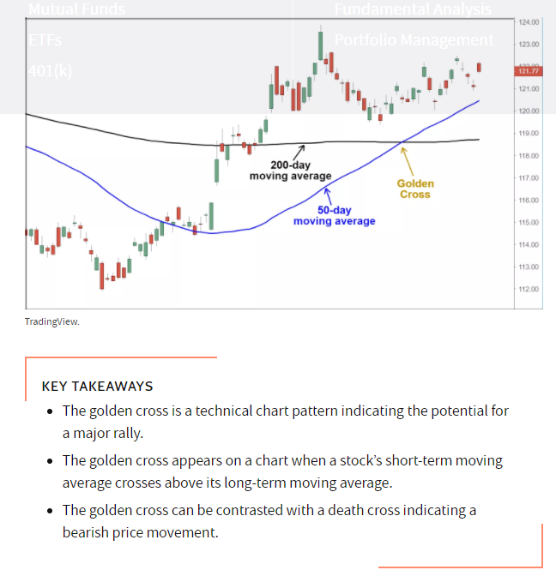
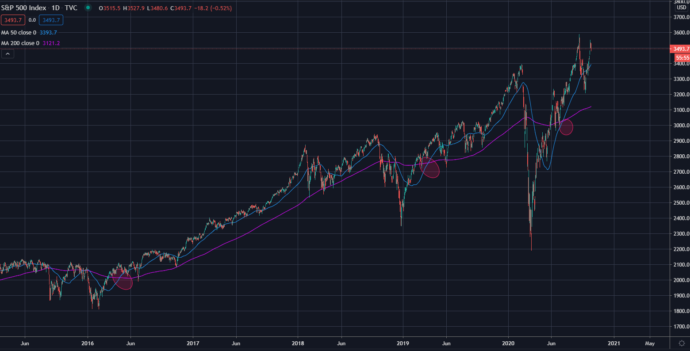
Feature engineering – golden cross strategy

Slide 14
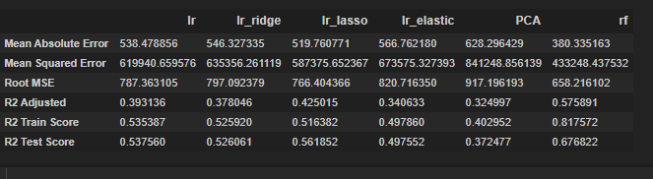
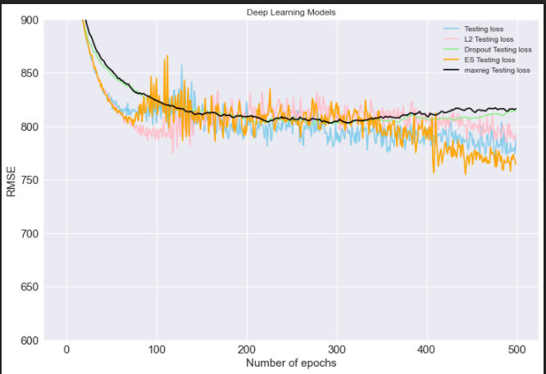
Model evaluation and metrics
Random Forest
RMSE : 658
Highest R2 Adjusted
Train and test score
Notes:
Adjusted R Squared refers to the statistical tool which helps the investors in measuring the extent of the variance of the variable which is dependent that can be explained with the independent variable and it considers the impact of only those independent variables which have an impact on the variation of the dependent variable.
The higher the R2 Adjusted it means the predictors have higher explanatory power for the predicted value

Slide 15
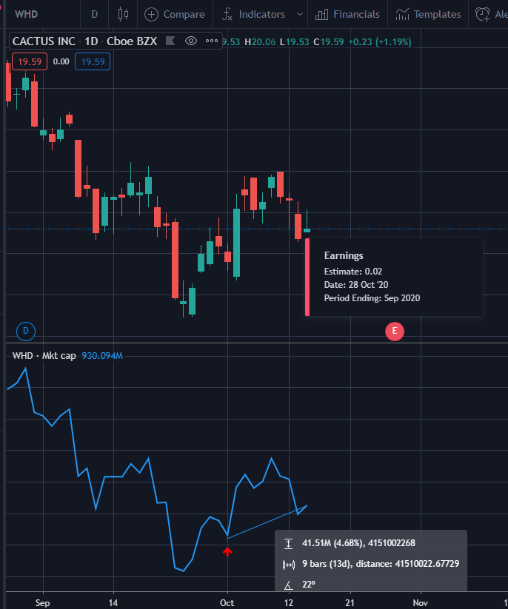
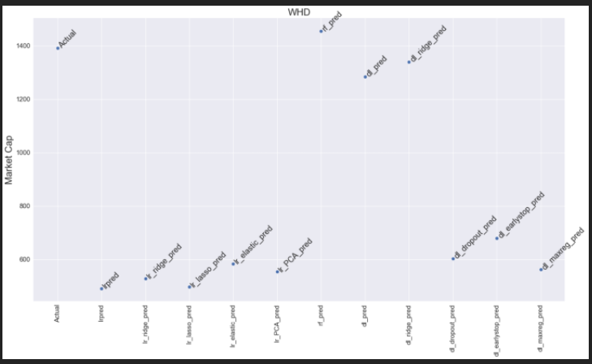
Whd - Cactus, Inc. * Earnings date 28 oct 2020
- Next Earnings Date : 28 Oct 2020
- 01 Oct 2020 Market Cap = US\$1.39 Billion
- 14 Oct 2020 Market Cap = US\$1.51 Billion
- Predicted Value = US\$1.46 Billion
- Sector: Energy , Industry : Oil and Gas Equipment Services
- Insti ownership : 50.7%
- EPS: 1.29
- Gross Margin : 34.9%
- Random Forest Predicts that WHD should increase valuation to $1.46 Billion
- Status: Random Forest prediction on track, super exceed

Slide 16
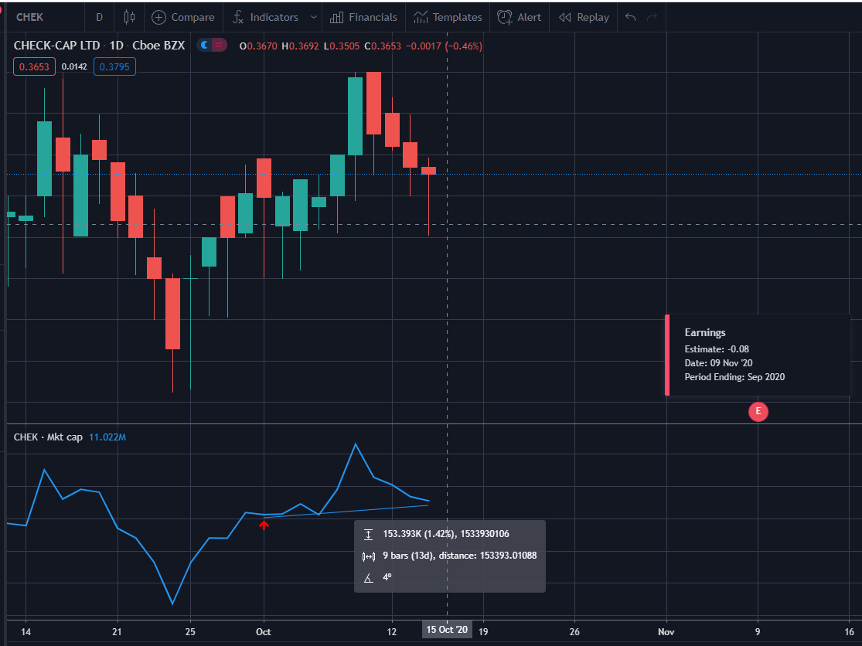
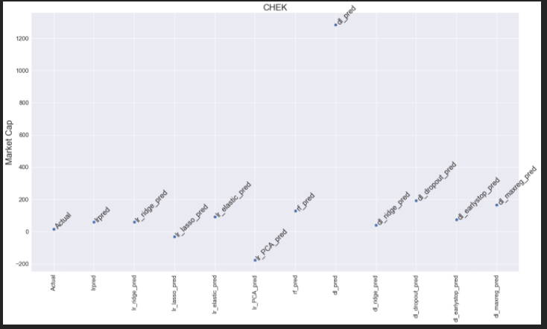
CHEK - Check-Cap Ltd. Earnings date 09 nov 2020
- Next Earnings Date : 09 Nov 2020
- 01 Oct 2020 Market Cap = US\$15.76 Billion
- 14 Oct 2020 Market Cap = US\$17.53 Billion
- Predicted Value = US\$129.45 Billion
- Sector: Healthcare , Industry : Diagnostics & Research
- Insti ownership : 5.9%
- EPS: 0.11
- Gross Margin : 53%
- Random Forest Predicts that CHEK should increase valuation to $129.45 Billion
- Status: Random Forest prediction on track

Slide 17
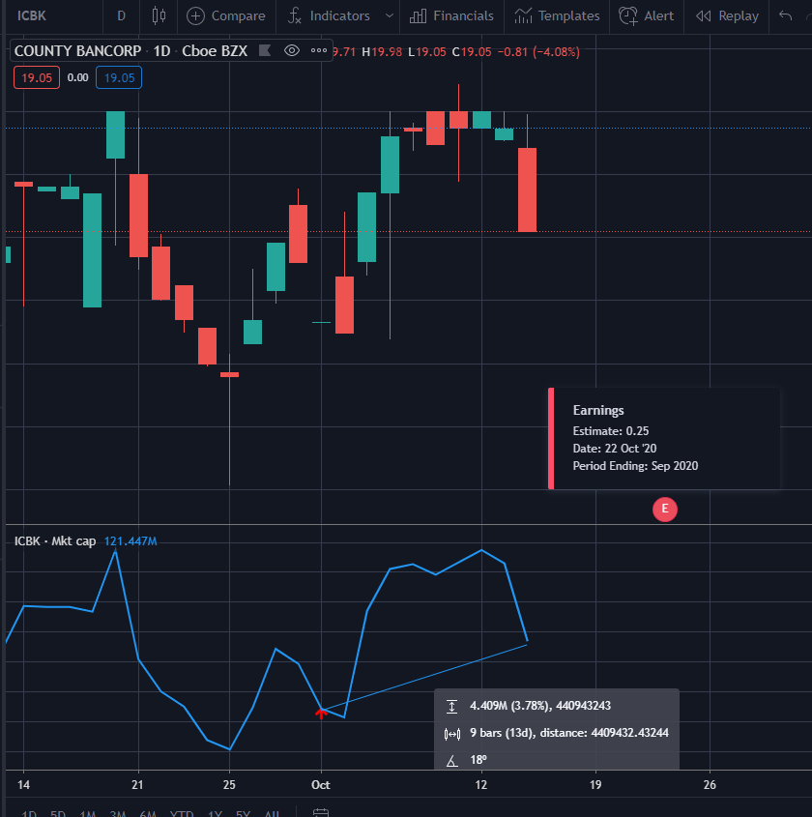
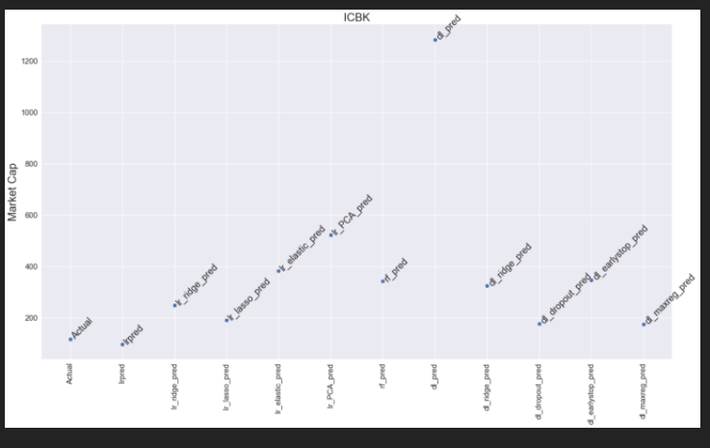
Icbk - County Bancorp, Inc. earnings date 22 oct 2020
- Next Earnings Date : 22 Oct 2020
- 01 Oct 2020 Market Cap = US\$116.4 Billion
- 14 Oct 2020 Market Cap = US\$119.63 Billion
- Predicted Value = US\$314.47 Billion
- Sector: Financial , Industry : Banks - Regional
- Insti ownership : 27.4%
- EPS: 0.90
- Gross Margin : 64%
- Random Forest Predicts that ICBK should increase valuation to US\$314.47 Billion
- Status: Random Forest prediction on track

Slide 18
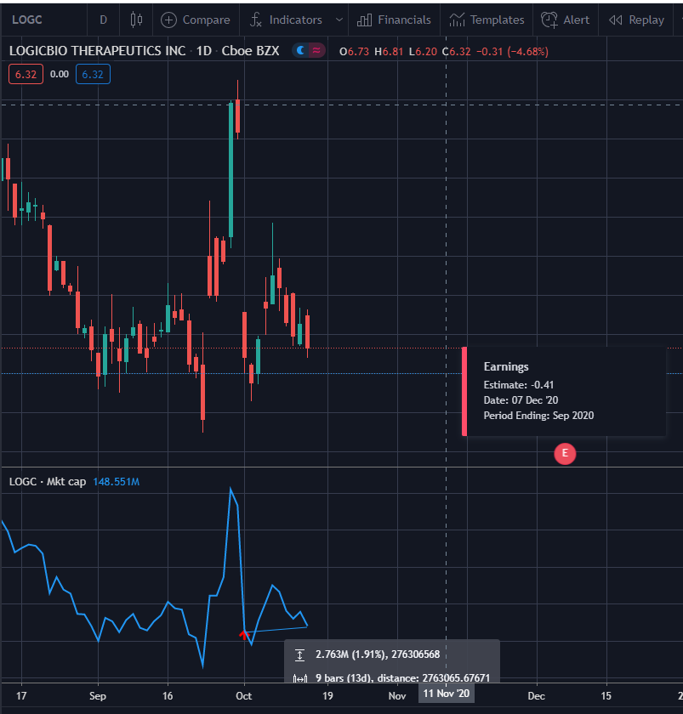
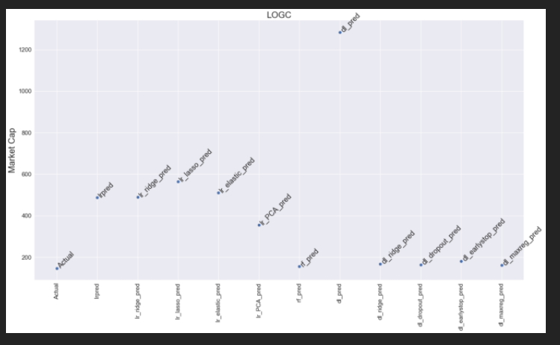
Logc – logicbio therapeutics earnings date 07 dec 2020
- Next Earnings Date : 07 Dec 2020
- 01 Oct 2020 Market Cap = US\$146.57 million
- 14 Oct 2020 Market Cap = US\$213.81 million
- Predicted Value = US\$155.23 Billion
- Sector: Healthcare , Industry : Biotechnology
- Insti ownership : 64%
- EPS: 1.89
- Gross Margin : 53%
- Random Forest Predicts that LOGC should increase valuation to US\$155.23 million
- Status: Random Forest prediction on track, super-exceeded

Slide 19
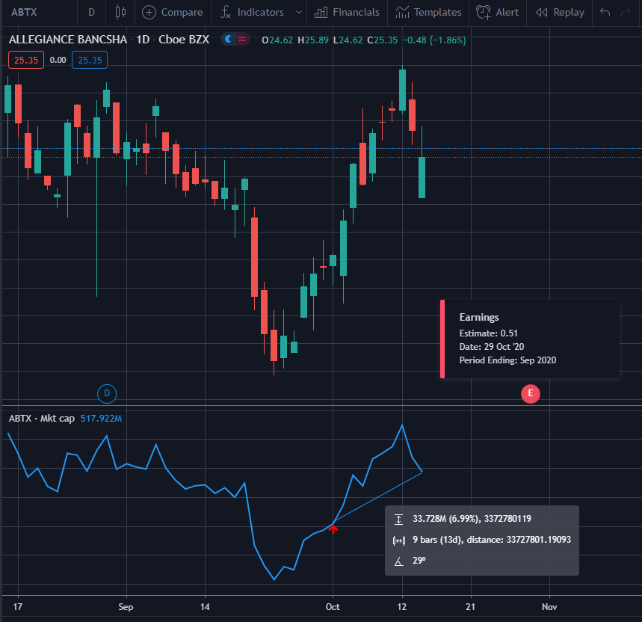
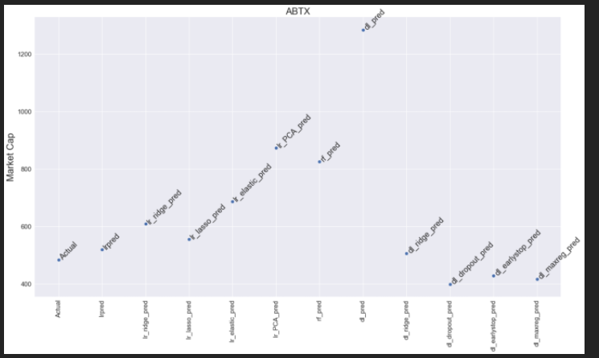
AbTx – allegiance Bancshares earnings date 29 oct 2020
- Next Earnings Date : 29 Oct 2020
- 01 Oct 2020 Market Cap = US\$484.54 Million
- 14 Oct 2020 Market Cap = US\$513.59 Million
- Predicted Value = US\$826.02 Million
- Sector: Financial , Industry : Banks Regional
- Insti ownership : 46.90%
- EPS: 1.88
- Gross Margin : 64%
- Random Forest Predicts that LOGC should increase valuation to US\$826.02 Million
- Status: Random Forest prediction on track

Slide 20
CONCLUSION
Overview
- Random forest, 5/5 on track on going up, with 1 of the companies hitting the predicted price.
- A super star, WHD, the only model predicted that the market cap should increase, all others predicted a lower valuation.
- Understanding which financial vitals
-Predicted Market Cap
- Know which companies to buy
- Know when to take profit
- Going short on companies over-valued
Notes:
5

Slide 21
Conclusion
Limitations
- Companies under US$5 billion
- Time Expiration
- 5 random stocks
- Deep Learning Parameters
Notes:
5 random stocks, turned out to be a double edge sword, it managed to choose all the 5 random forrest that are doing well

